Slide 1

Introduction about the Course
BCSE204L Design and Analysis of Algorithms
Session #1
Dr. T. JOSHVA DEVADAS
Associate Professor Senior
Department of Analytics
School of Computer Science and Engineering (SCOPE)
Vellore Institute of Technology (VIT)
Vellore
joshvadevadas.t@vit.ac.in

Slide 2
Contact Information
Office Cabin: SJT Annex (WTP) 103 F
Email: joshvadevadas.t@vit.ac.in
Mobile Number: 97895 60120
Open Hours:
Wednesday: 11:00 am to 12:00 Noon

Slide 3
BCSE204L Design and Analysis of Algorithms
L T P C
3 0 0 3

Slide 4
Objective
1. To provide mathematical foundations for analyzing the complexity of the algorithms
2. To impart the knowledge on various design strategies that can help in solving the real world problems effectively
3. To synthesize efficient algorithms in various engineering design situations

Slide 5
Expected Course Outcome
On completion of this course, student should be able to:
1. Apply the mathematical tools to analyze and derive the running time of the algorithms
2. Demonstrate the major algorithm design paradigms.
3. Explain major graph algorithms, string matching and geometric algorithms along with their analysis.
4. Articulating Randomized Algorithms.
5. Explain the hardness of real-world problems with respect to algorithmic efficiency and learning to cope with it.

Slide 6
Data Structures ( so far …)
Primitive DS
Non-Primitive DS
Int
float
Linear( Sequential)
Non Linear
(Random)
char
Double
Pointer
Arrays
List
Stack
Queue
Trees
Graph
Single LL
Double LL
Circular LL
Binary Tree
Binary Search Tree

Slide 7
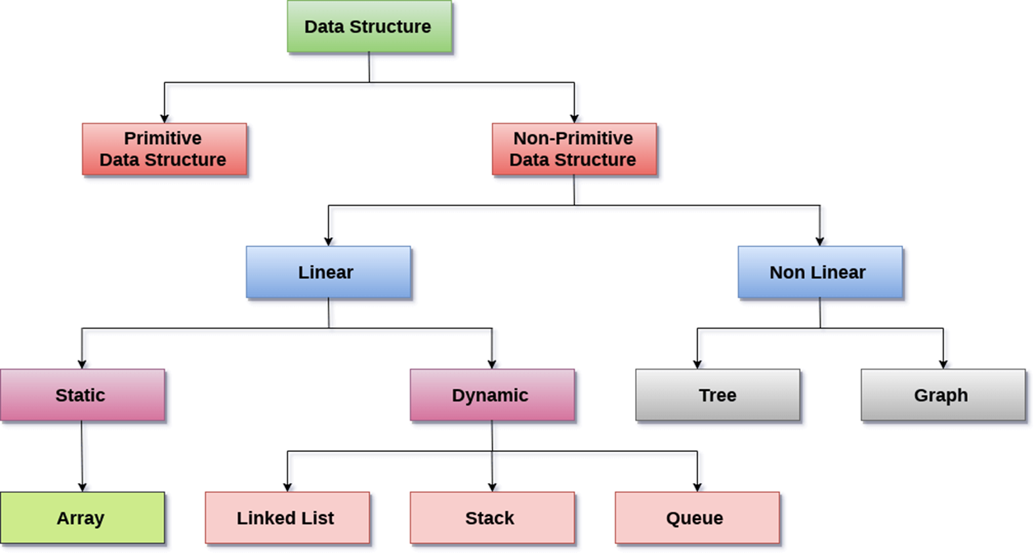

Slide 8
Operations
Sorting
Searching
Insertion
Deletion
Updating

Slide 9
Modules
Design Paradigms: Greedy, Divide and Conquer Techniques
Overview and Importance of Algorithms - Stages of algorithm development: Describing the problem, Identifying a suitable technique, Design of an algorithm, Derive Time Complexity, Proof of Correctness of the algorithm, Illustration of Design Stages - Greedy techniques: Fractional Knapsack Problem, and Huffman coding - Divide and Conquer: Maximum Subarray, Karatsuba faster integer multiplication algorithm.

Slide 10
Design Paradigms: Dynamic Programming, Backtracking
Dynamic programming: Assembly Line Scheduling, Matrix Chain Multiplication, Longest Common Subsequence, 0-1 Knapsack, TSP- Backtracking: N-Queens problem, Subset Sum, Graph Coloring- Branch & Bound: LIFO-BB and FIFO BB methods: Job Selection problem, 0-1 Knapsack Problem
String Matching Algorithms:
Naïve String-matching Algorithms, KMP algorithm, Rabin-Karp Algorithm, Suffix Trees

Slide 11
Graph Algorithms
All pair shortest path: Bellman Ford Algorithm, Floyd-Warshall Algorithm - Network Flows: Flow Networks, Maximum Flows: Ford-Fulkerson, Edmond-Karp, Push Re-label Algorithm – Application of Max Flow to maximum matching problem
Geometric Algorithms
Line Segments: Properties, Intersection, sweeping lines - Convex Hull finding algorithms: Graham’s Scan, Jarvis’ March algorithm.
Randomized algorithms
Randomized quick sort - The hiring problem - Finding the global Minimum Cut.

Slide 12
Classes of Complexity and Approximation Algorithms
The Class P - The Class NP - Reducibility and NP-completeness – SAT (Problem Definition and statement), 3SAT, Independent Set, Clique, Approximation Algorithm – Vertex Cover, Set Cover and Travelling salesman.
Contemporary Issues
  Recent trends in algorithms analysis and design
TextBook
Thomas H. Cormen, C.E. Leiserson, R L.Rivest and C. Stein, Introduction to Algorithms, Third edition, MIT Press, 2009.

Slide 13
Reference Books
1. Jon Kleinberg and ÉvaTardos, Algorithm Design, Pearson Education, 1st Edition, 2014.
2. Rajeev Motwani, Prabhakar Raghavan; Randomized Algorithms, Cambridge University Press, 1995 (Online Print – 2013)
3. Ravindra K. Ahuja, Thomas L. Magnanti, and James B. Orlin, Network Flows: Theory, Algorithms, and Applications, 1st Edition, Pearson Education, 2014

Slide 14
Assessment Methods -Theory
CAT1 – As per Dean Academics Scheduled Date
CAT2 – As per Dean Academics Scheduled Date
QUIZ 1 (Moodle) [NEXT Week after CAT1 EXAM]
QUIZ 2 (Moodle) [NEXT Week after CAT2 EXAM]
Digital Assignment 1(Moodle) - 29th April 2024
Final Assessment Test (FAT)

Slide 15
BCSE204P Design and Analysis of Algorithms
L T P C
0 0 2 1

Slide 16
Course Objectives
1. To provide mathematical foundations for analyzing the complexity of the algorithms
2. To impart the knowledge on various design strategies that can help in solving the real
world problems effectively
3. Synthesize efficient algorithms in various engineering design situations
Course Outcomes
On completion of this course, students should be able to:
1. Demonstrate the major algorithm design paradigms.
2. Explain major graph algorithms, string matching and geometric algorithms along with their analysis.

Slide 17
Indicative Experiments
1. Greedy Strategy : Activity Selection & Huffman coding
2. Dynamic Programming : ALS, Matrix Chain Multiplication , Longest Common Subsequence, 0-1 Knapsack
3. Divide and Conquer : Maximum Subarray and Karatsuba faster integer multiplication algorithm
4. Backtracking: N-queens
5. Branch and Bound: Job selection
6 String matching algorithms : Naïve, KMP and Rabin Karp,suffix trees
7 MST and all pair shortest path algorithms
8 Network Flows : Ford –Fulkerson and Edmond - Karp
9 Intersection of line segments &Finding Convexhull, Finding closest pair of points
10 Polynomial time algorithm for verification of NPC problems
11 Approximation and Randomized algorithms

Slide 18
Assessment Methods - Lab
Assessment Lab 1 – 10 Marks - ( 29th Jan 2024 )
Assessment Lab 2 – 10 Marks - ( 19th Feb 2024 )
Assessment Lab 3 – 10 Marks – ( 18th Mar 2024 )
Assessment Lab 4 – 10 Marks – ( 15th Apr 2024 )
Mid-Term Lab Exam – 20 Marks ( 15th April 2024 )
Lab FAT – 40 Marks ( 29th April 2023 )

Slide 19
Contact Information
Office Cabin: SJT ANNEX (WTP) 103 F
Email: joshvadevadas.t@vit.ac.in
Mobile Number: 97895 60120
Open Hours:
Wednesday: 11:00AM to 12:00Noon

